Slide 1
Build New Sites with Liferay DXP
Liferay DXP Basics
Business
Liferay DXP 7.4

Slide 2
Key Module Takeaways
Sites in Liferay DXP act as repositories that store all Liferay Assets
Site Templates and Page Templates are useful tools for cutting time to market and customizing the look and feel of Sites
Site Membership comes in three varieties, Open, Restricted, and Private, and can be used to control access to certain content
Permissions on a specific Site can be assigned through Site Roles or Teams

Slide 3
Exercise Prerequisites
Unzipped module exercise files in the following folder structure:
Windows: C:\liferay
Unix Systems: [user-home]/liferay
Liferay DXP 7.4 set up and running
If you have not started your Liferay instance yet, set it up with the following basic configuration:
Portal Name: Mondego
First Name: Test
Last Name: Test
Email: test@mondego.com
Notes:
Check out the Liferay Foundations: Introduction to Liferay DXP course if you have questions on starting a new instance of Liferay DXP

Slide 4

Intro to Use Case: The Mondego Group
The Mondego Group needs a customer self-service portal to empower customers to find answers and resolve issues on their own
Mondego also needs a public website that:
Attracts customers with targeted content
Implements an intuitive user journey
Reaches the appropriate audience
Notes:
Previous example: The Mondego Group, a multinational financial services organization, needs an employee intranet, Mondego Loop, to improve interdepartmental communication and connectivity

Slide 5


Relevant KPIs
Increase customer satisfaction and empowerment with a customer self-service portal
Decrease cost of customer support with self-service solutions
Decrease time to market for new Sites and Pages

Slide 6
Creating Reusable Page Structures

Slide 7
What are Page Templates?
Page Templates are pre-configured pages used to rapidly generate new Site pages
Content Page Templates—created and managed on any Site
Widget Page Templates—managed on the Global Site
Page Templates allow you to:
Rapidly add similar types of pages to Sites throughout the platform
Create a consistent look and feel
Quickly make changes to Pages by enabling Inherit Changes
Notes:
Notes:
There are two main types of Page Templates:
Widget Page Templates are added in the Global Site and give the page a layout, widgets (e.g., Asset Publisher, Message Board, Blogs), and content instead of starting out with a blank page.
Content Page Templates are created using Page Fragments and widgets; they will be covered in more depth on the next slide.
Page Templates are beneficial because they allow you to rapidly build out a site with a consistent look and feel across the platform, giving Content Creators, Administrators, and Designers less to worry about.
Page Templates not only speed up page creation when a Site is initially built, but also allow for changes to be made more quickly when Inherit Changes are configured for Widget Pages or by configuring Fragment Propagation.
Note that when Inherit Changes is activated, individual instances of the Widgets on the page can no longer be customized. If students will need to turn automatic propagation off, they will need to go to that page's Configuration menu and turn off the Inherit Changes option.
For Fragments, propagation can be configured manually for a single Fragment or automatically for all Fragments, though the latter should only be used for testing or development purposes to prevent errors. More details on Page Fragments can be found in the module “Building a Website Using Experience Management Tools,” or in the Technical Module “Creating Page Fragments.”
Use Case:
The Mondego Group has several Sites that require the same types of Pages, including a page for signing up for an account, product and informational pages, and a page to contact customer support. By creating Page Templates on the Global Site, Mondego can easily populate any new Sites with these required Pages without having to build them from scratch. Individual Sites can use Content Page Templates to quickly create new pages specific to the needs of that Site. For instance, one Mondego Site may create Content Page Templates for Financial Advice Articles.

Slide 8
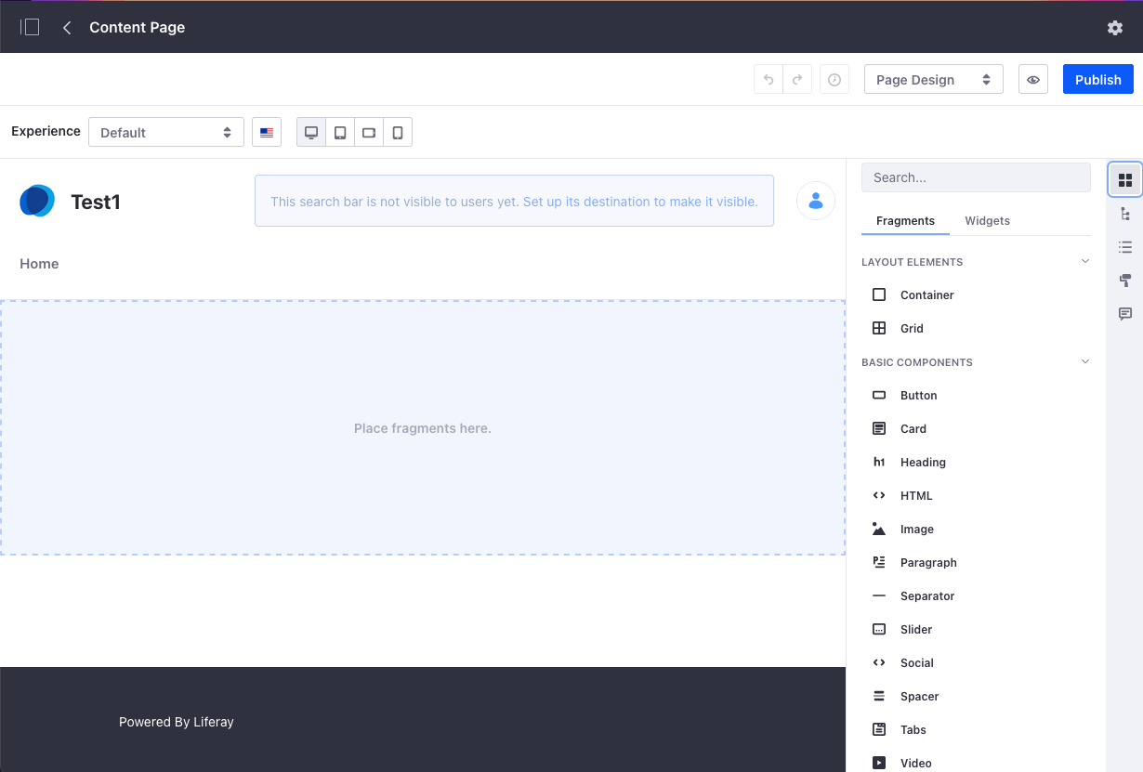
Content Pages
Content Pages are the default page type in Liferay DXP
Content Pages are built primarily using Page Fragments with the option to also use widgets
Content Page Templates can be created on any Site and are organized into Collections
Notes:
Notes:
A few important things to keep in mind for Content Page Templates:
Changes to Content Page Templates are not automatically propagated
A Collection must be created before a Content Page Template can be added
Page Fragments, the key component of Content Pages, are reusable page elements that include editable components, such as text, images, and links. These elements can be mapped to available content. More information on Content Pages and Page Fragments is included in Module 5, Building a Website with Experience Management Tools.
Content Pages are edited using the Site Builder. Content Pages can also be enabled with custom Workflows and adapted to create personalized experiences and alternative versions. Keep in mind, new Content Pages will remain as Drafts until they are published.
Use Case:
The Mondego Group can use Content Pages to quickly design new pages and directly edit content on the page. Content Pages also allow the Group to create personalized experiences for Users through the Page Experiences and the Responsive Layout. Rather than existing as a single static page, a well-designed Content Page can include text, images, and more that can change depending on the User. One version of the page can include a prompt for guest users to sign up for a Mondego account while an existing User might see options for how to manage their account.

Slide 9
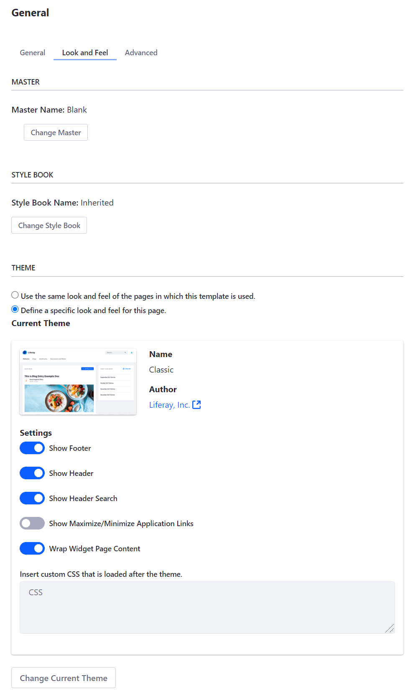
Configuring Page Templates
SEO settings can be defined by adding metadata to the Page Template
Platform administrators can update each of the following for a Page Template:
HTML title
Description
Keywords
Notes:
Notes:
Custom Themes can be applied specifically to the Page Template. JavaScript and icons can be added to a Page Template using the Advanced Features section of page configuration.
Use Case:
By configuring SEO optimization at the Page Template Level, Mondego page creators and site admins can ensure that all Pages made from a template have the same metadata, keywords, and other settings applied. For example, a Page Template created for Special Offers and Promotions can include appropriate tags or categories so that all promotional pages using the template can be found using those metadata.

Slide 10
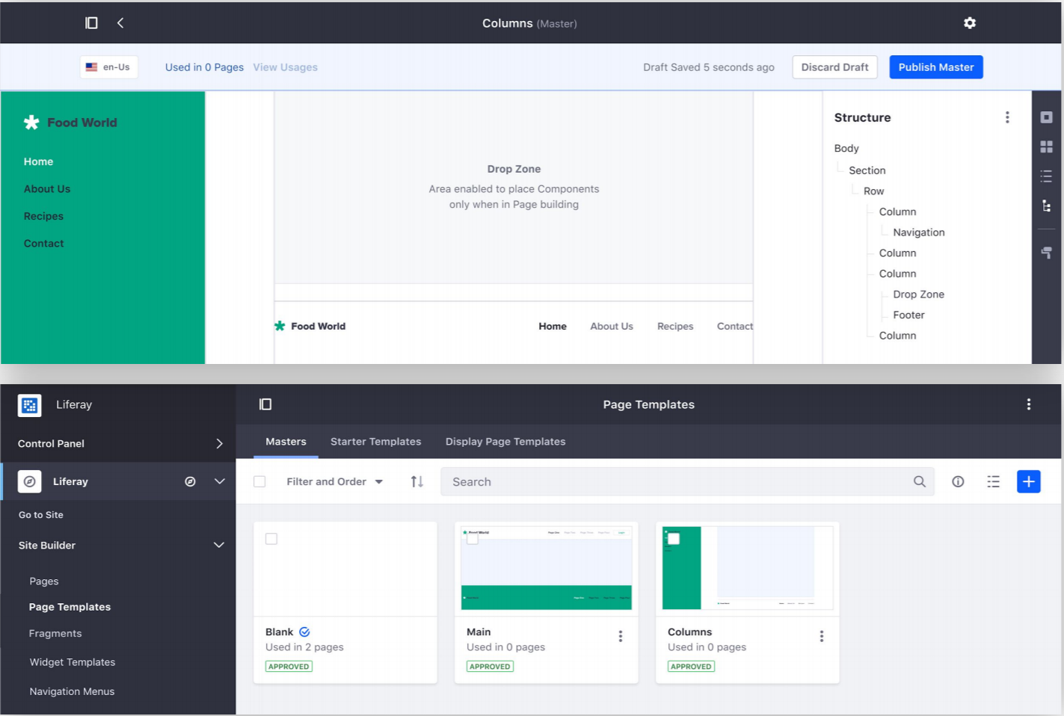
Master Pages
Master Pages allow non-developers to define Master Page Templates which can be used throughout a site
With Master Pages, Users can easily define:
Rows and Columns
Headers, footers, navigation, etc.
Which Fragments can be deployed
Where Users can in-line deploy Fragments and Widgets
Notes:
Notes:
All pages must be associated with a Master Page Template. The default Master Page Template is Blank with no defined elements.
Master Page Templates can be used for an entire Site or for individual Pages.
Use Case:
By creating a Master Page, it is possible to ensure that all Pages on a Mondego Site include a standard header with the Mondego logo, a navigation menu for easy access to the rest of the Site, and a footer with relevant links and contact information. This Master Page can then be used to generate additional templates or simply to create new Pages within the Site.

Slide 11
Use Case Example: Mondego Page Templates
The Mondego Group can easily utilize the variety of Page types, tools, and templates available with Liferay DXP to quickly create new Pages for its Sites
With a Content Pages, the Web Team can quickly create a visually engaging Home Page using Fragments and Widgets
The team can use Page Templates to design a standard layout for informational pages on Mondego’s different services and products
The Web Team can also ensure uniformity across the Site by using a Master Page that includes the Mondego logo, a header, and a footer of useful links

Slide 12
Knowledge Check
The Mondego Group can quickly create Pages with defined layouts, styles, and widgets using Page Templates.
Master Page Templates can be used to ensure that the Mondego header, footer, and other essential content items are included on every page on the Site.
Mondego can build Pages using the default Content Pages, which utilize Page Fragments for quick and easy designs.

Slide 13
Knowledge Check
The Mondego Group can quickly create Pages with defined layouts, styles, and widgets using Page Templates.
Master Page Templates can be used to ensure that the Mondego header, footer, and other essential content items are included on every page on the Site.
Mondego can build Pages using the default Content Pages, which utilize Page Fragments for quick and easy designs.

Slide 14
Exercise: Add Pages to the Platform

Slide 15
Add Pages to the Platform Exercise Objectives
Create the Mondego Group Site
Create a Master Page Template to use across the main Mondego Site
Create a Content Page Template for Informational Pages
Use the Account Content Page Template to create a page for Personal Banking Accounts
Create a Widget Page Template for a Landing Page
Use the Template to create a Landing Page for Mondego's Sites

Slide 16

Add Pages to the Platform Exercise Steps (1/2)
Create the Mondego Group Main Site
Create a Master Page Template
Create a Content Page Template Using the New Master
Add Fragments to the Page Template
Create a Page with the Accounts Page Template

Slide 17
Add Pages to the Platform Exercise Steps (2/2)
Create a Global Landing Page Template
Configure the Widget Page Template
Add Language and Content Widgets to the Template
Create a Page with the Landing Page Template
Update the Master Page Template for the Landing Page

Slide 18

Add Pages to the Platform Bonus Exercises
Add another Content Page Template called Credit Cards to the Mondego Group Site. Pick two Fragments and one Widget to use on the page. Create at least one new page on the Mondego Group Site using the new template. View the new page in the Navigation Menu.
Create another Widget Page Template on the Global Site to use for Financial Advice. Use a Web Content Display widget, a Blogs widget, and a Message Boards widget. Choose whichever layout you prefer.

Slide 19
Creating Sites with Site Templates

Slide 20
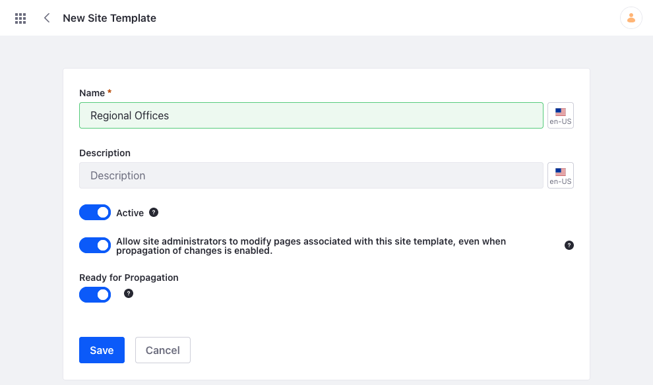
What are Site Templates?
Site Templates are predefined sets of pages, layouts, widgets, and content
Site Templates allow for the quick creation of Sites across a platform
New site templates can be created by going to Control Panel → Sites → Site Templates
Notes:
Notes:
New sites created from a Site Template have all the pages and widgets that were added in the Site Template.
Site Templates can only be accessed from the Control Panel, unlike Sites, which can be accessed using the Site Selector or in the Control Panel.
Both Sites and Site Templates use the same Site Administration panel once a user has selected their Site/Site Template.
Sites built using a Site Template must designate whether the default pages are created as Private or Public. Public and Private Sites will be discussed further in the next Module.
Use Case:
As a large organization with different subsidiaries, regional branches, internal groups, partners, and more, Site Templates provide a way to quickly generate similar sites across the platform without building each Site from scratch.

Slide 21
Rapidly Generating New Sites
Sites created from a Site Template will have the same pages, widgets, and content as the template
Content created in a Site Template will act as the default content of a new Site created using that template
Site Administrators and developers can add new pages, widgets, and content to a Site created from a template
Notes:
(Change Screenshot)
Notes:
This slide should define how Site Templates can be used to create new sites and what benefits that provides. Make sure to go over the difference between page management in Page Templates versus page management in Site Templates. Creating a site where pages are already filled out with content allows for the fastest site generation, provided very little of the content needs to be replaced or added onto.
**Moving forward from DXP 7.4, the default site will be created through a site initializer. This will allow for more flexibility when it comes to adding elements (such as fragments, style books or master pages) in the future.
Use Case:
To build on our use case, Mondego has several regional offices for the Banking subsidiary. Each region needs its own website with some general information about the Group as a whole and with basic pages and layout already established. By creating a Mondego Banking Regional Office site template, these Sites can be easily created for each region.

Slide 22
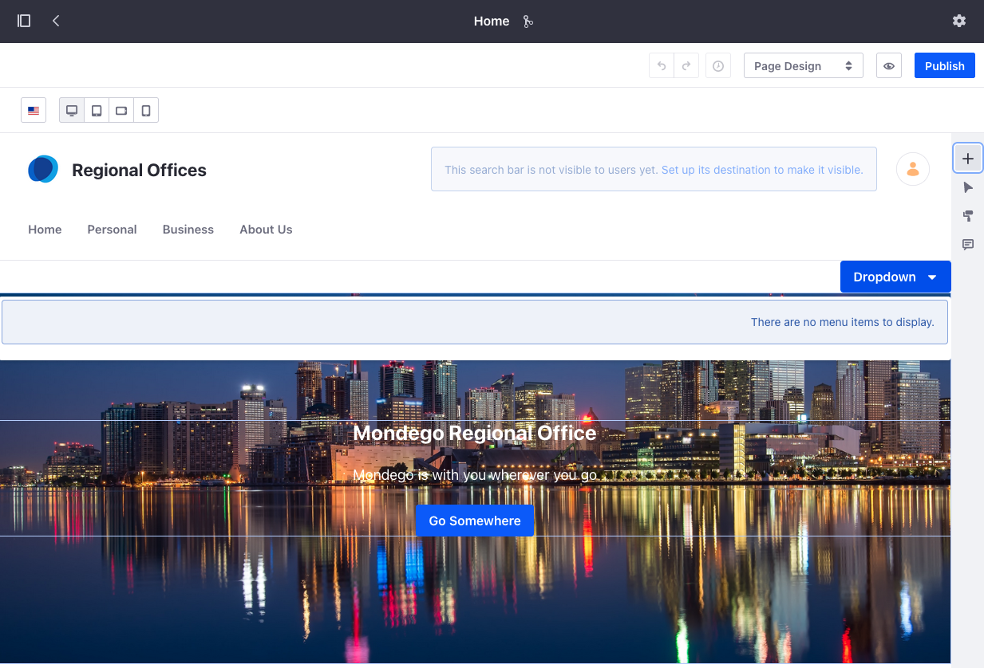
Sites Built From Site Templates
Changes made to a Site Template are automatically reflected in Sites that use it when propagation of changes is enabled
Pages added to a Site that are not part of the original Site Template will be unaffected by modifications to the template
Notes:
Notes:
By default, new Site Templates are set to enable propagation of changes. This can be disabled on the General Site Settings page. Sites with this option disabled will not inherit any changes made to the pages, content, or widgets in the Site Template.
Within the Site Template, you also have the option to Disable Propagation (the fork symbol at the top of the site) while you make changes and then Enable it once the template is ready.
Pages added after a Site is created from the template exist separate from the template components and are managed from the specific Site Administrator panel.
Use Case:
If the Mondego Group decides to update the main page of all Regional Offices sites to reflect a new change in the company, these changes will automatically show up on any Sites utilizing the template as long as propagation of changes is enabled. Rather than changing every Home Page to include a new banner, button, or form, the admin can change the page in the template.

Slide 23
Use Case Example: Mondego Regional Sites
Since the Mondego Group needs several different Sites, both for internal and external users, Site Templates enable the team to quickly create Sites
The Web Team can create a Site Template to use for all branch and regional office Sites ensuring a uniform appearance across the platform
If the Web Team decides to redesign the Sites for regional offices, they can enable the propagation of changes and revise the Site Template, automatically updating all Sites made from the template

Slide 24
Knowledge Check
_______________ can be created to predefine page set widgets, configuration, and even content, to rapidly generate new sites for the Mondego Group.
The default option Enable Propagation of changes from the Site template allows Mondego Site pages to inherit changes made to the template.
Inherited changes from a _______ Template lock down the page from configuration changes, while inherited changes from a _______ Template still allow for administrative flexibility for the Mondego Web Team.

Slide 25
Knowledge Check
Site Templates can be created to predefine page set widgets, configuration, and even content, to rapidly generate new sites for the Mondego Group.
The default option Enable Propagation of changes from the Site template allows Mondego Site pages to inherit changes made to the template.
Inherited changes from a Page Template lock down the page from configuration changes, while inherited changes from a Site Template still allow for administrative flexibility for the Mondego Web Team.

Slide 26
Exercise: Add Sites to the Platform

Slide 27
Add Sites to the Platform Exercise Objectives
Create a Site Template for Mondego Regional Office locations
Use the template to create Sites for some of Mondego's regional banks

Slide 28
Add Sites to the Platform Exercise Steps
Create a Site Template for Mondego Regional Offices
Add a Personal Banking page to the Site Template
Add child pages for Checking Accounts, Savings Accounts, and Mobile Banking
Finish creating the page structure for the Site Template
Create a new Site using the new Site Template
Create two more Regional Bank Office Sites with the Site Template

Slide 29
Add Sites to the Platform Bonus Exercises
Create a Site Template for Mondego’s Business Banking sites. It should have at least three pages that include at least one fragment on them.
Add Mondego Regional Office Sites for Mondego locations in Chile and Germany. Make sure they are created as Child Sites of the main Mondego Site.
Add a custom Content Page to one of the new Mondego Regional Office Sites created from the Site Template. Navigate to the new Site and look at the Pages you added within the Site itself..

Slide 30
Managing Site Configuration

Slide 31
Site Membership
Sites in Liferay have three different kinds of membership:
Open—Any user can become a member of the Site at any time
Restricted—A user can request membership to a Site, but the Site Administrator must approve the user’s request
Private—Users cannot request Site membership but must be manually selected and added as a member by the Site Administrators
Notes:
Notes:
Site Membership grants a user access beyond that of a Guest. Site Members can view Private Pages, have more permissions on widgets for content creation, and can be associated with Roles.
Open and Restricted Sites can be viewed by anyone, but Users must request membership to join Restricted Sites.
Private Sites can only be viewed by those who are already Members, and membership is manually granted by the Site Administrator.
Use Case:
Mondego can utilize the different kinds of Site Membership for its Sites in a number of ways. Mondego could create a Private Site for investor or partners where Users are manually added by the Site Administrator. Membership for Mondego Banking sites can be set to Restricted, allowing customers to request access but requiring membership approval to ensure that members are actual customers. Mondego might use Open Membership for customer service or community forum sites where anyone can join the conversation, answer questions, or engage with other members.

Slide 32
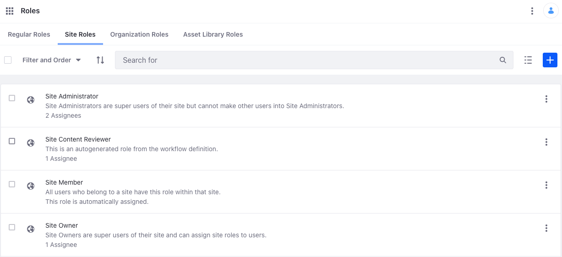
Sites Roles
Site Roles are a unique way of giving users access to do more within a site
Site Members can be assigned Site Roles
These are a set of permissions on site resources given to users assigned the role
Site Roles are defined for all sites, and custom roles are added platform-wide
Notes:
Notes:
Roles are how permissions are assigned to different Users. Roles exist at the Regular, Site, Organization and Asset Library levels.
Site Roles are roles that are scoped to individual Sites. Users with Membership in a Site can be granted additional permissions and access when they are assigned a Site Role.
Site Roles are managed in the Control Panel under Users→ Roles. The default Site Roles are Site Administrator, Site Content Reviewer, Site Member, and Site Owner.
Keep in mind that Roles can be assigned but cannot be created by Site Administrators (or Owners). If a Site Administrator needs to assign a set of permissions to a User(s), they can use Teams, which is discussed on the next slide.
Use Case:
In order to keep Mondego’s customer service portal running efficiently and reduce the work of the Platform Administrator, the Administrator assigns Site Roles to several members. The Site Owner has the ability to assign Site Roles to Users and the Site Administrator can manage every aspect of the Site. All users of the Site are automatically assigned the Site Member Role. For other tasks that don’t require as many permissions, such as reviewing an informational article, the Site Content Reviewer can be assigned.

Slide 33
Teams
Teams are groups of Site Members that have permissions on a specific Site resource
Site Roles vs. Teams:
Site Roles can give access to any number of resources in a Site
Teams only grant permissions for Site-specific tasks and resources
Teams are the preferred method for Site Administrators to assign permissions within a single Site
Notes:
Notes:
Teams also allow for flexibility over membership and are ideal for ad hoc groups of users.
Since Site Administrators cannot create Custom Roles, Teams allows Site Admins control over permissions granted to Users.
Primary examples of using Teams over Site Roles include:
Message Board management
Blog creation
Page editing
Use Case:
The Site Administrator for the Mondego Customer Service Site needs to assign permissions to a set of Users so that they can answer customer submitted questions. Rather than require the Platform Administrator to create a new role specifically for this purpose, the Site Administrator can create a designated FAQ Team with permissions that allow the Team to answer questions.

Slide 34
Public vs. Private Pages
Public Pages are used to build a website that is visible to the public; they do not require Site membership to access pages
Private Pages are hidden from non-members but allow Members to interact with and collaborate on content
Liferay DXP allows public and private pages to coexist within the same Site
Private pages of a Child Site can only be accessed by members of the Parent Site if they are also members of the Child Site
Notes:
Notes:
Private pages can exist on Open Sites; Users with membership can access them while Guests can only see Public pages.
Since Private Sites require membership to view, truly Public pages cannot exist on Private Sites.
The control over which users can see and act on Pages in Liferay DXP is a key feature of Liferay Sites.
Child Sites will be discussed in more detail on the next slide.
Use Case:
Much like Mondego’s use of Open, Restricted, and Private Sites, Private and Public Pages provide the option to limit what is and is not publicly visible. For its main Site, Mondego should use Public Pages to create an engaging website with clear information for potential customers. The main Site can also include Private Pages that are only visible once users log in.

Slide 35
Site Hierarchies
Organizing Sites hierarchically allows content to be easily shared between Sites
Site Administrators can enable content sharing so that content types, such as document types, present in Parent Sites automatically appear in Child Sites
Roles and Members are not automatically inherited:
Site Administrators of a Parent Site do not automatically inherit the Site Administrator Role of the Child Sites
Child Sites do not inherit the Members and Roles of their Parent Sites
Access needs to be defined for each individual Site
Notes:
Notes:
Content that can be shared across hierarchical Sites include web content structures and templates, document types, vocabularies and categories, widget templates, and data definitions.
If a Site Administrator creates a Child Site, they maintain the same permissions in the Child Site. Otherwise, a specific role based on the Site Administrator role must be created with the Manage Subsites permission to grant administrative access to all Sites in a hierarchy.
Unlike Organization hierarchies, which only manage Users, Site hierarchies organize pages, content, application data, and Users.
Additional details on creating Roles and granting Permissions can be found in the “Add Users and Manage Permissions” Module.
Use Case:
With many subsidiaries and suborganizations, Mondego can organize Sites hierarchically to reflect the organizational structure. This also enables them to share content types between Sites in the hierarchy. For instance, the main Mondego site may have a vocabulary established for categorizing Publications and Media. By enabling the sharing of this content, the Child Sites created for the main regional offices can also use the Publications and Media Vocabulary to sort their own content.

Slide 36
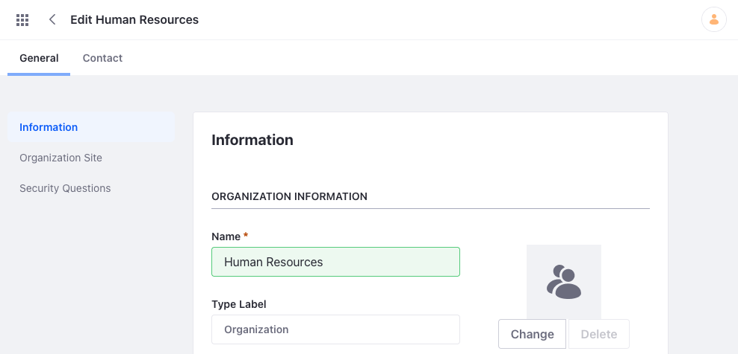
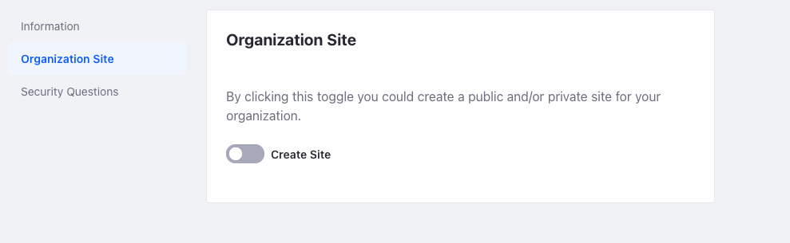
Sites and Organizations
Sites can be associated with Organizations
Organizations allow Users and Sites to be arranged in a way that reflects real world organizational hierarchies
Organization Sites can be created when you create an Organization
Notes:
Notes:
Sites can be created completely independent of an organization and do not need to be associated with one.
Organizations are similar to Site hierarchies but do not require a Site. Users and Members of an Organization can be granted a set of permissions based on their role.
Use Case:
To add structure to its platform, the Mondego Group can add Organizations based on its real-world organizational structure. For example, Mondego can create a Human Resources Organization with sub-organizations for Payroll, Recruiting, Generalists, and more. An Organizational Site can also be created to serve as the main HR portal.

Slide 37
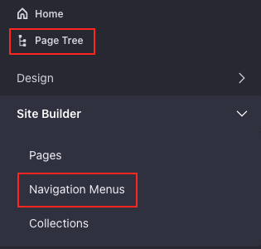
Site Navigation
Liferay DXP separates Site-scoped information from the Control Panel by placing it in the Site Administration panel
Custom Navigation Menus make Sites easier to traverse
Navigation Menus can be managed from the Site Administration panel in the Page Tree or under Site Builder
Notes:
Notes:
As a refresher, Site-scoped information is accessed in the Site Administration panel, located on the left side of the UI.
Navigation menus are managed under Site Builder → Navigation Menus or under Page Tree → Navigation Menus.
In DXP 7.3 and earlier, Navigation Menus are added to the Page using the Navigation Menu widget.
DXP 7.4 includes two new options for adding navigation features, the Menu Display and Dropdown fragments. These fragments and additional information on creating custom navigation bars and menus will be covered in a later module.
Use Case:
By creating custom Navigation Menus, Mondego can improve the navigability of certain areas on the Site. For instance, one of its sites includes a collection for financial advice. A “Financial Advice” item can be included in the main menu to direct users to all the articles and a custom Navigation Menu including specific topics, media type, and more can be included on specific Financial Advice pages to improve user navigation of those pages.

Slide 38
Use Case Example: Mondego Site Management
To better manage Mondego’s Sites and members, the Web Team uses several configuration tools included with Liferay DXP
The Web Team builds the main Mondego Site using Public Pages so that anyone, including Guests, can access the website
The Customer Portal includes a Public landing page and Private pages that require Site membership, which is set to Restricted
The Web Team also needs to assign members appropriate Roles within a Site:
The Mondego Banking Site and its branch-specific Child Sites each have an assigned Site Administrator with authorization to manage the Site, assign additional roles, and create Site Teams

Slide 39
Knowledge Check
Mondego Sites include three different kinds of Site Memberships:
Open, general access
Restricted, requires an account
Private, access granted by Administrator
Mondego’s main Site features Public pages that reach a broader audience while Private pages feature customer-specific content.
Sites are organized hierarchically to keep track of the growing Mondego Group, its subsidiaries, and its internal structure. This also gives Administrators more precise control over pages, content, app data, and site members.

Slide 40
Knowledge Check
Mondego Sites include three different kinds of Site Memberships:
Open, general access
Restricted, requires an account
Private, access granted by Administrator
Mondego’s main Site features Public pages that reach a broader audience while Private pages feature customer-specific content.
Sites are organized hierarchically to keep track of the growing Mondego Group, its subsidiaries, and its internal structure. This also gives Administrators more precise control over pages, content, app data, and site members.

Slide 41
Exercise: Manage Site Configuration

Slide 42
Manage Site Configuration Exercise Objectives
Create a Private Site on the Mondego platform called Mondego Matters to serve as an employee intranet
Create a Restricted Site for Mondego Publications
Manage Site membership and configuration in the new Sites
Add Private and Public Pages to the Mondego Publications Site

Slide 43
Manage Site Configuration Exercise Steps
Add the Mondego Matters employee intranet
Add the Mondego Publications site
Add a Public Blog Page to the Mondego Publications Site
Add Private Pages on the Mondego Publications Site

Slide 44
Manage Site Configuration Bonus Exercises
Add pages to the Mondego Matters site. Use two Private Pages and two Public Pages. Sign out of the Administrator account and view the Site as a guest.

Slide 45
Summary (1/2)
Page Templates are pre-configured pages used to rapidly generate new site pages.
Page Templates come in two varieties: Content and Widget.
Master Page Templates allow Users to define Master Page elements that can be used throughout a Site.
Site Templates are predefined sets of pages, layouts, widgets, and content.

Slide 46
Summary (2/2)
Platform Administrators can control what content is viewable to whom by defining the Site Membership type and distinguishing between Public and Private pages.
Organizing Sites hierarchically allows Administrators to better organize pages, content, app data, and Site Members and to share content types across Sites.
Site Roles, Teams, and Organizations can be used in different ways to organize Users and manage permissions.

Slide 47
For Further Reading
For more information on Building Sites, consult the documentation here:
https://learn.liferay.com/dxp/latest/en/site-building/building_sites.html
For general questions about using Liferay’s products, visit:
https://learn.liferay.com/index.html

